Slide 1


GameSAT
Play to learn.

Slide 2

Overall Project

Slide 3
Current Features
Close Button
Restart button
Help button
Skip question
Game Mode
Point based system
5 levels of varying difficulty
Bonus point system
Training Mode
No point system
Missed questions will show up more frequently

Slide 4
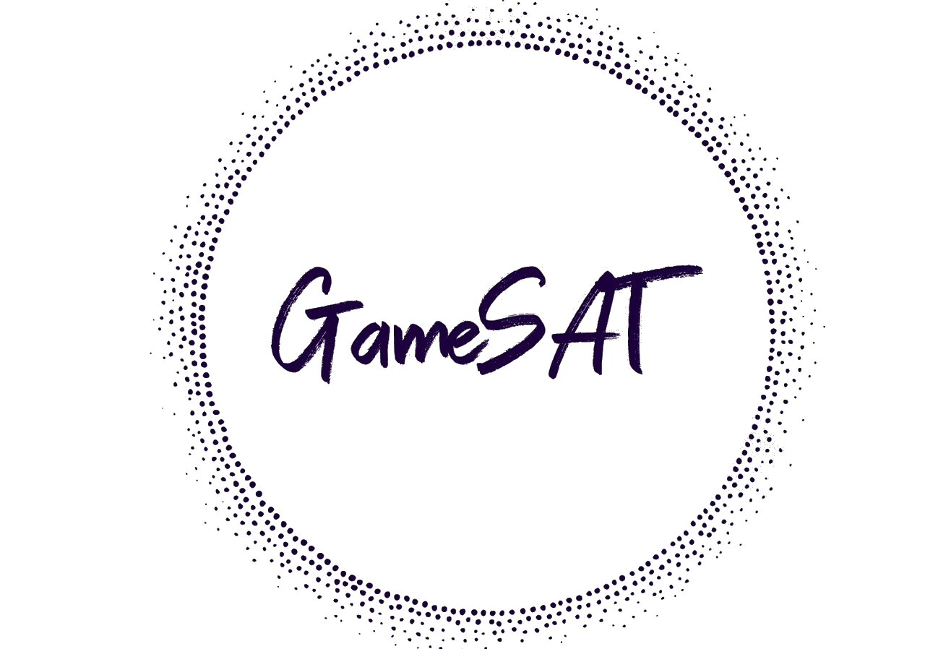
Current Outcomes
GameSAT builds an emotional connection to learning and the subject matter
Player learns more actively from the reward and competitive based system of the game.

Slide 5

User Profile: Texas Tech Students
Age | 23-30
Sex | Male, Female
Ethnicity | Asian, White
Major | Computer Science, Advertising plus Digital Media & Communication
Classification | Senior

Slide 6
General Questions
Question | Yes/Likely | No/Unlikely
Do you have Computer/IT experience? | 3 | 0
Do you play app games? | 3 | 0
Did you use an app to prepare for your SAT/GRE? | 0 | 3
How likely are you to use an app game as a learning tool? | 3 | 0
How likely are you to use this product? | 3 | 0

Slide 7
Interview Results

Slide 8
"What aspects of the games, made you enjoy those games?"
Interviewer A
Easy to pick up
Play for a short while
Interviewer B
Different challenge each time you play a level
Each level must be slightly more challenging than the previous, that way it never gets boring
Interviewer C
Involved critical thinking
Entertainment

Slide 9
"What resources did you find most helpful in preparing for SAT/GRE? How were they helpful?"
Interviewer A: Pre-existing knowledge of word roots and etymology
Interviewer B: Repeatedly answering practice questions.
Interviewer C:
Khan Academy
Good explanations
Problems mimicked real SAT problems.

Slide 10
“Any functionality that should be added?”
Interviewer A
Interviewer B
Interviewer C
Global ranking system
Reward-based system
Ability to track progress between rounds, and to see in what areas I’m improving or not improving the most
Reading passages

Slide 11
New Features
Passage Game with text from Nautilus and Quanta magazines.
Global Rank of the 10 fastest times to reach the max score.
Stat Tracker to record the user performance and help their progress.

Slide 12
New Outcomes
A game that will appeal to a larger audience
A game that emulates the actual exams to a greater extent
A game that will expand the user's vocabulary through enjoyable reading.

Slide 13
References
Introduction To The GRE. (n.d.). Retrieved January 29, 2021, from https://crunchprep.com/beginners-guide-to-gre/introduction-to-gre
GRE Volumes by Country. Retrieved January 29, 2021, from https://www.ets.org/s/gre/pdf/gre_volumes_by_country.pdf
Nearly 2.2 Million Students in the Class of 2020 Took The SAT At Least Once. (n.d.). Retrieved January 29, 2021, from https://newsroom.collegeboard.org/nearly-22-million-students-class-2020-took-sat-least-once#:~:text=9%2F9%2F2020-,Nearly%202.2%20Million%20Students%20in%20the%20Class%20of,The%20SAT%20At%20Least%20Once&text=New%20York%E2%80%94Nearly%202.2%20million,Assessments%20Program%20Results%20released%20today.
“Why Use Games to Teach?” Games, 7 May 2018, https://serc.carleton.edu/introgeo/games/whygames.html
University, Stanford. “Using Games as an Educational Tool Provides Opportunities for Deeper Learning, Panelists at Stanford Event Say.” Stanford News, 1 Mar. 2013, https://news.stanford.edu/2013/03/01/games-education-tool-030113/
“Digital Pedagogy - A Guide for Librarians, Faculty, and Students: Game Based Learning - Why Do It: Benefits, Challenges.” Research Guides, https://guides.library.utoronto.ca/c.php?g=448614&p=3505475

Slide 14

Thanks

